Slide 1




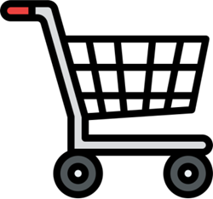



Functioning Of Super Market Billing System
CSE111 || Data Structures
Supervisor : prof. Mohamed Abdelaziz
Dr. Radwa Taher

Slide 2
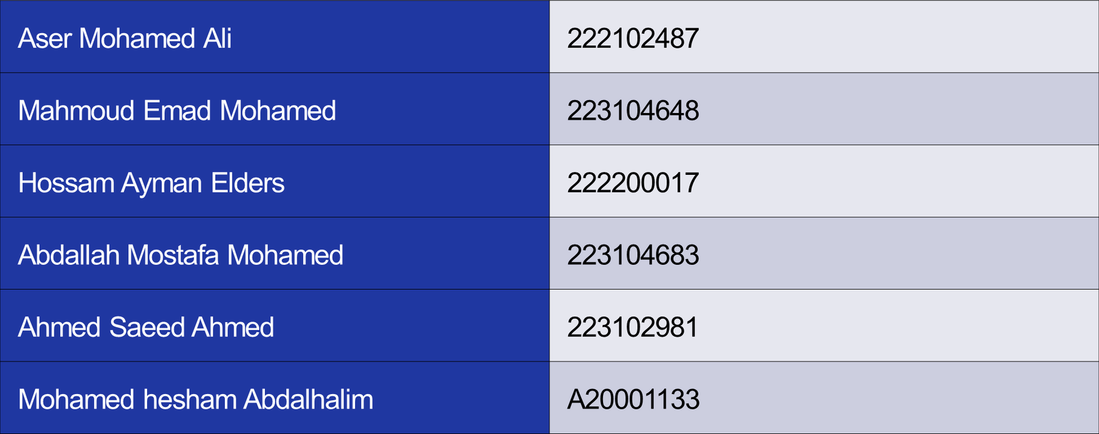
Team members

Slide 3
Introduction
The supermarket billing system automates the basic functions required for the fast and correct billing .
The software is made efficient and fast by using the data structures that we have learnt to minimize the complexity in code.
This software is designed to ease the work for administrator (user friendly) and reduce the waiting time for the customer .

Slide 4
Aim
The aim of the supermarket billing system is to have an efficient way to serve supermarket function fast and accurate.
No customer wants to wait for their turn for a long time. This happens with an unorganized billing system.

Slide 5
Scope | Applicability
The system saves organization costs and resources by eliminating paper usage for billing .
Provide instant product and price information to save time and providing a flexible, user-friendly interface.

Slide 6
Purpose
This process is completely software based and does not need many workers to manage the work .
It makes your billing system faster, simpler and more efficient .

Slide 7
Solution | Idea
Customer Management: Track customer details and easily modify product information.
Scalable Algorithm: Develop an efficient, editable program that can serve as a module for larger systems.

Slide 8
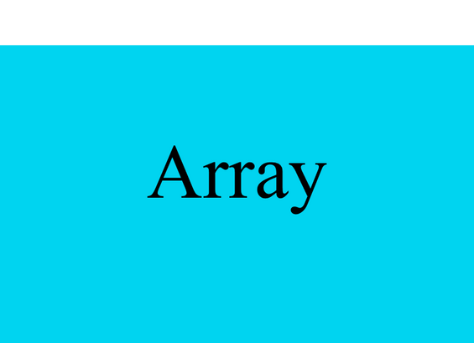

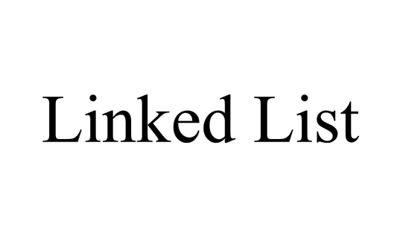
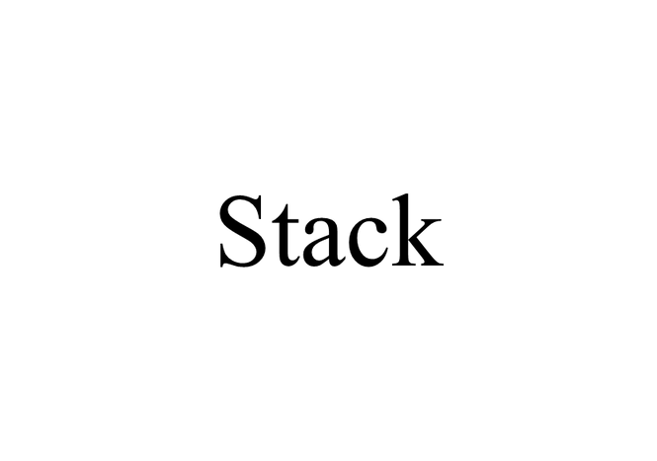
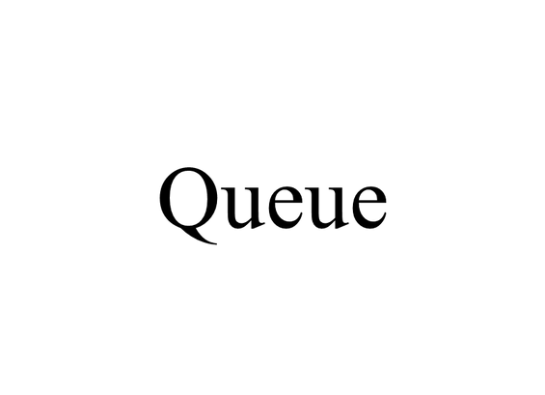
Concepts of data structures used

Slide 9
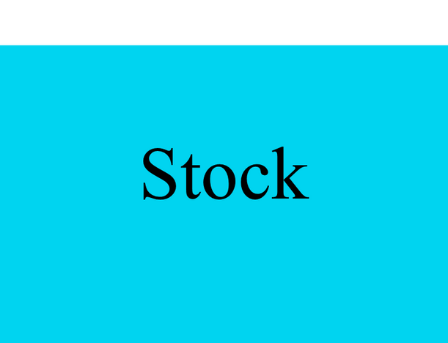

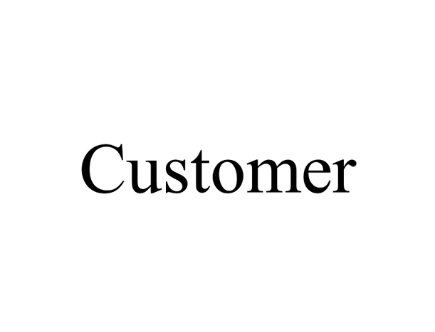
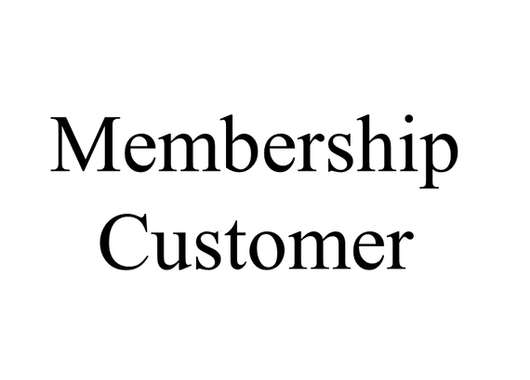
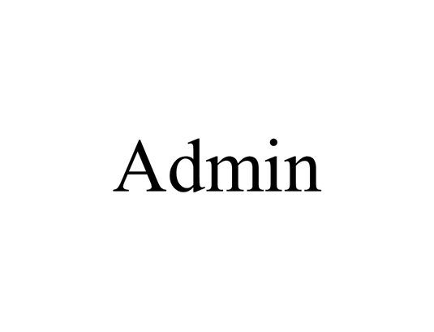
List of modules

Slide 10
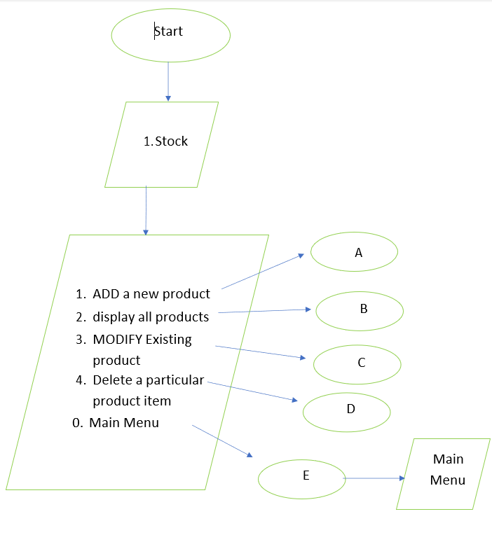
1- STOCK (Linked list, Array list)
a. Add Product: Enter product details (ID, Name, Price, Quantity) using a linked list.
b. Display Products: Show available products, prices, and quantities using an array list.
c. Modify Products: Update product details if faulty or stock changes.
d. Remove Items: Remove unavailable or expired products from the list.
e. Back to Main Menu: Return to the main menu to access the customer menu or exit.

Slide 11
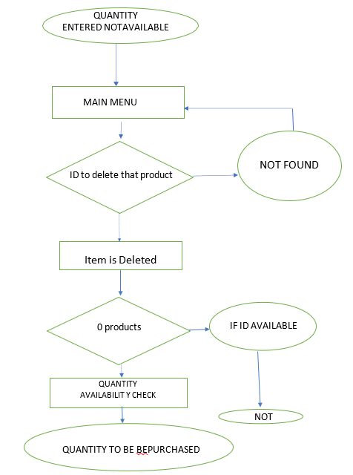
2- CUSTOMER (Stack, Array, Queue)
a. Assign Basket: Assign a trolley number to the customer using a stack of size (50).
b. Buy Items: Add selected products to the basket (trolly) with quantities. If out of stock, return to the main menu.
c. Enter Customer Queue: Add the customer to the queue (enqueue) after item selection.

Slide 12
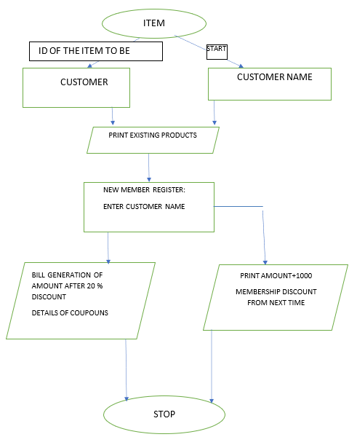
3- MEMBERSHIP CUSTOMER (Stack, Array, Queue)
a. Existing Member: Current members receive discounts and coupons (20% discount, 500 EGP coupon).
b. New Member Registration: New members can register; fees are added to the final amount, with future discounts.
c. Same Functions: Other functions and data structures are the same as in the customer module.

Slide 13
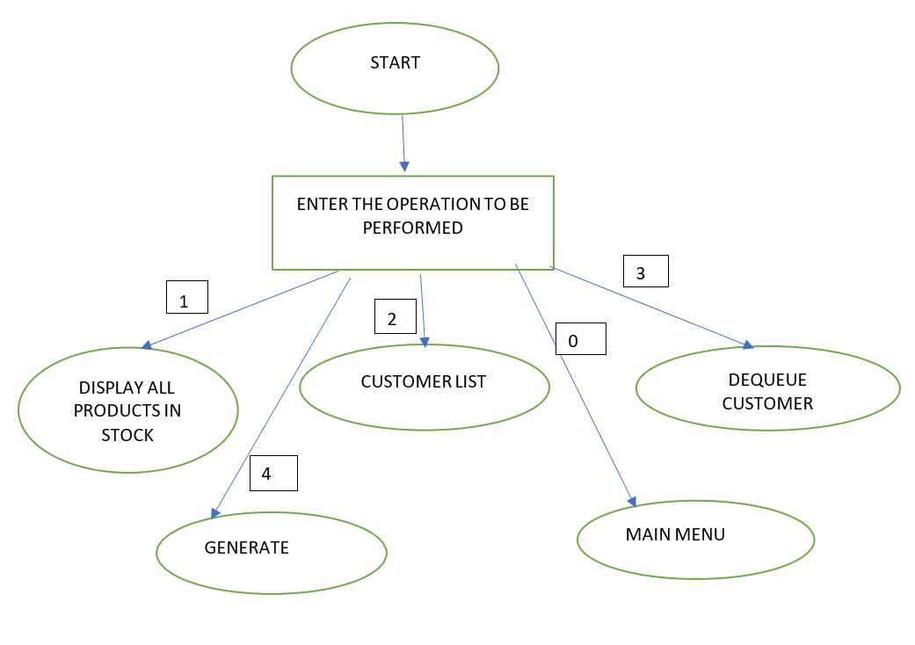
4- ADMIN (Array list, Linked queue)
a. Display Products: Show available products with prices and quantities using an array list.
b. Customer List: Manage online traffic with a first-come, first-served (FIFO) queue using a linked queue; customers are added via ENQUEUE.
c. Dequeue Customer: Remove customers from the queue after they receive their product using DEQUEUE.

Slide 14
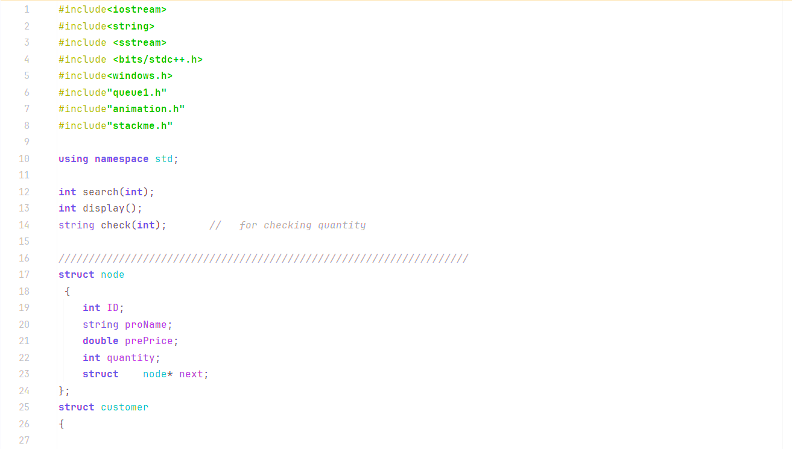
The main super market billing code

Slide 15
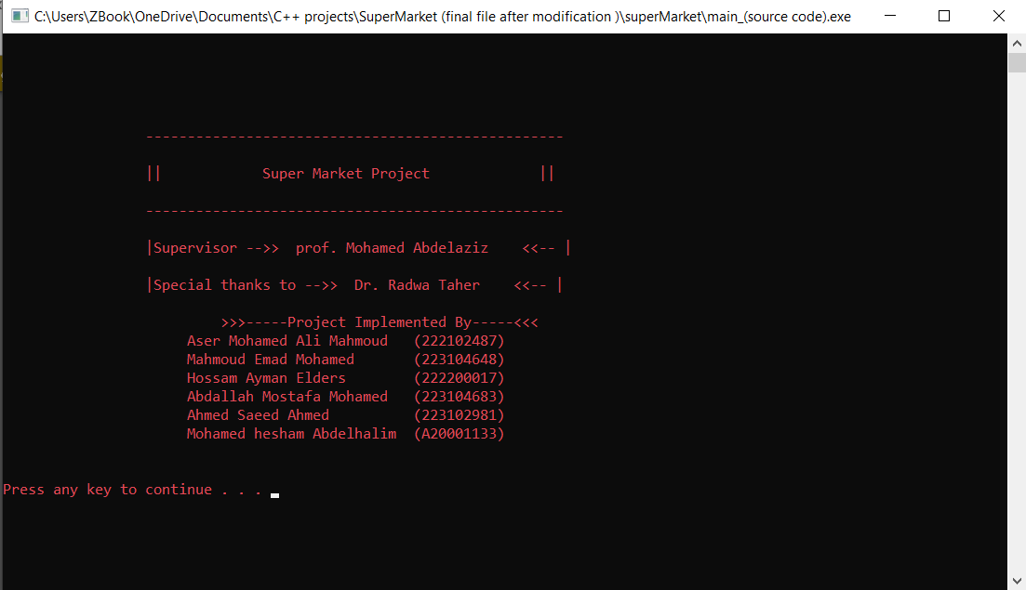
Results and discussion (working and outputs of code)

Slide 16
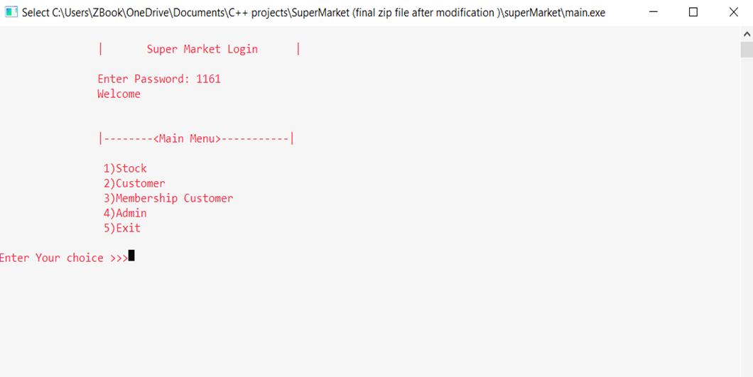
Lets play with the code and output (try different options)

Slide 17
Conclusion
A supermarket billing system now a days is completely being operated through software mode.
It makes the process easier, clear, uses less time, less energy, and more effective.

Slide 18
References
https://www.bing.com/ck/a?!&&p=e8605020cddb8ccaJmltdHM9MTcyMzQyMDgwMCZpZ3VpZD0wZGU3M2I1NC00MDgyLTYxNTUtMjg2My0yZmVjNDE1ZjYwMWEmaW5zaWQ9NTM3OQ&ptn=3&ver=2&hsh=3&fclid=0de73b54-4082-6155-2863-2fec415f601a&psq=data+structures+via+c%2b%2b+the+most+modern+referrences&u=a1aHR0cHM6Ly9jczYxLnNlYXMuaGFydmFyZC5lZHUvc2l0ZS8yMDIxL1NlY3Rpb24xLw&ntb=1
Pointers in C and C++. (2020, July 14). Journal Dev. Retrieved from: https://www.journaldev.com/30481/pointers-in-c-and-c-plus-plus
Vanessa Cross.(September 26, 2017). How to Run a Supermarket Business. Retrieved from: https://bizfluent.com/how-6808955 runsupermarket-business.html.
Reema, Thareja.(2014). Data structures using C, 2nd edition. Oxford University Press.
Narasimha, Karumanchi.(2014). Data Structures and Algorithms Made Easy, 2nd ed. Atlantic Publishers and Distributers.
Frank, Steeneken & Dave, Ackley. (January 2012). A Complete Model of Supermarket Business. Retrieved from: https://www.bptrends.com/publicationfiles/01- 03-2012- ARTSupermarket%20Article-steeneken-Ackley%20111226.pdf. BP Trends.
Krishnamoorthy, R., & Kumaravel, G. I. (2010). Data structures using C. New Delhi: Tata McGraw-Hill education Private.
Sahni, Sartaj. (2005). Data Structures, Algorithms and Applications in C++,2nd ed. Universities Press.
Wegner, Peter; Reilly, Edwin D. (2003-08-29). Encyclopedia of Computer Science. Chichester, UK: John Wiley and Sons.
Sara Baase, Allen Van Gelder. (1999). Computer Algorithms, Introduction to Design and Analysis, 3rd edition. Wesley Longman Publishing.
Thomas, H & Cormen Charles, E & Leiserson Ronald, L&Rivest Clifford, Stein. (May 2001). Introduction_ to_ Algorithm. The MIT Press, McGraw-Hill Book Company.
Ellis, Horowitz.(1983). Fundamentals of Data Structures in C, 2nd Edition. Computer Science Press. retrieved from: https://www.geeksforgeeks.org/pointers-andreferences-in-c/
Lipschutz, S. (101-). Data structures (SOS) (Revised first edition). McGraw- Hill Education.

Slide 19
Thank you

